Slide 1
The Ohio State University
Department of Dermatology

Slide 2
Our Mission
Thank you for your interest in
The Ohio State University Department of Dermatology Residency Program!
Our program’s mission is to provide a thorough education to help our residents grow into exceptional clinical dermatologists. Our residency program has a robust clinical and didactic curriculum that is rooted in the ACGME core competencies. A special emphasis is placed on producing dermatologists who will work with patient populations that are underserved for geographic or socioeconomic reasons and who will make important contributions to the future of dermatology by choosing careers as academic clinician educators.

Slide 3
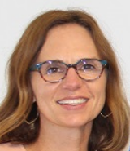
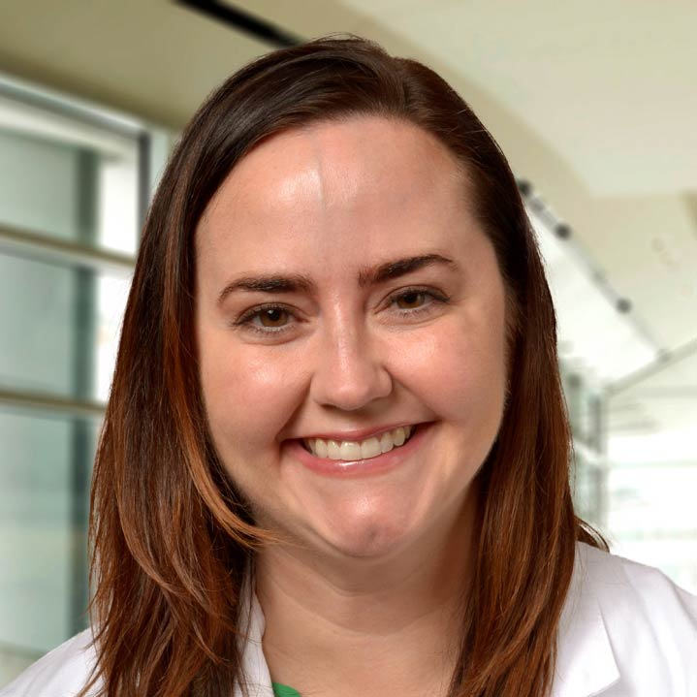
Program Leadership
Joy L. Mosser, MD, is the Director of the Dermatology Residency Program at The Ohio State University College of Medicine. She is also an attending dermatologist at Nationwide Children’s Hospital and Assistant Professor of Clinical Pediatrics. Dr. Mosser is board certified in dermatology and pediatric dermatology.
Kelly Tyler, MD, is the Assistant Director of the Dermatology Residency Program at OSU. She is board certified in both dermatology and gynecology. Dr. Tyler specializes in treating dermatologic disease in pregnancy, vulvar diseases and dermatologic surgery.

Slide 4
Meet our Residents

Slide 5
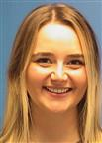
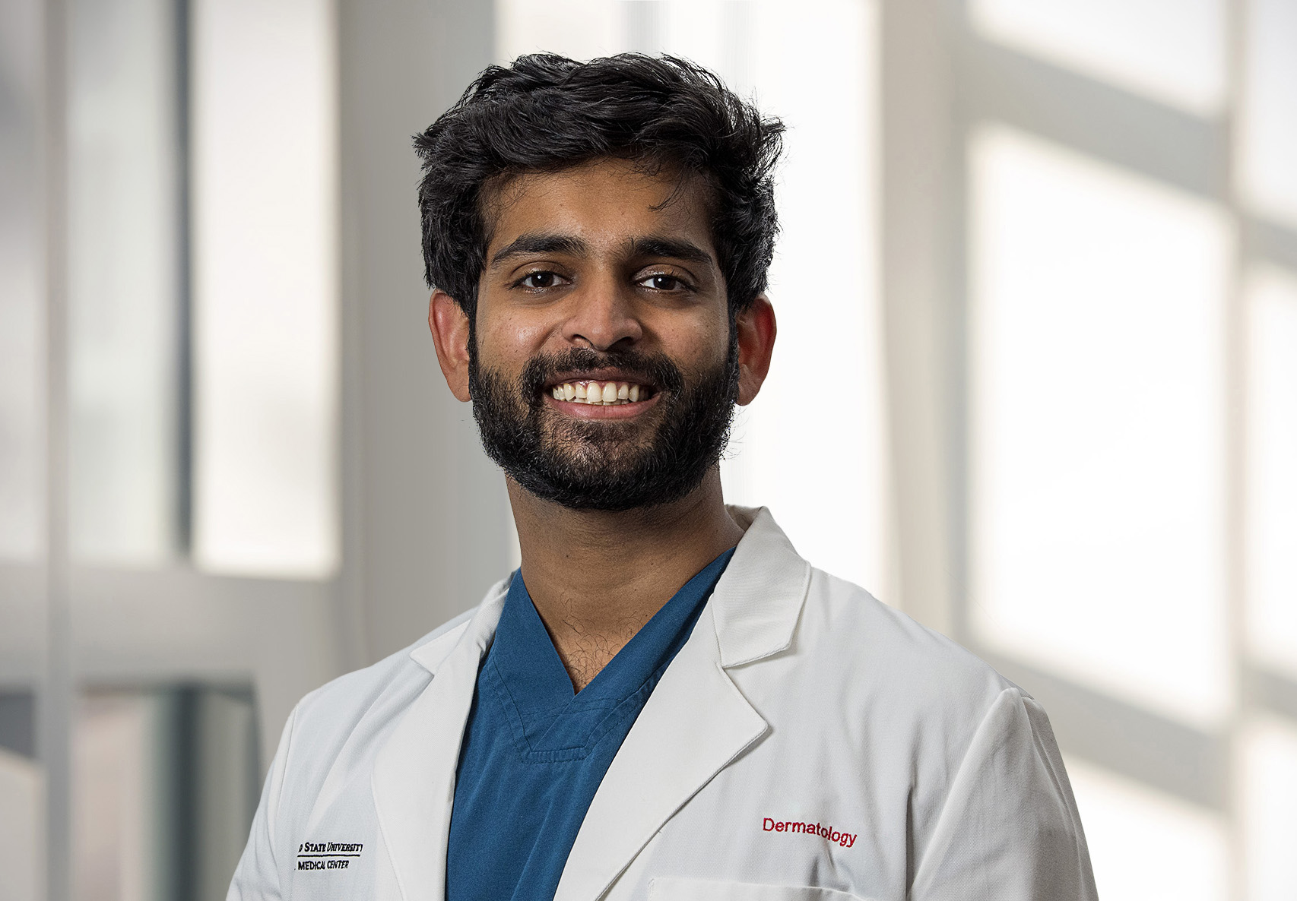
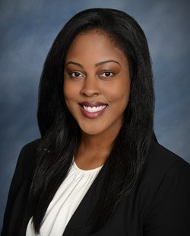
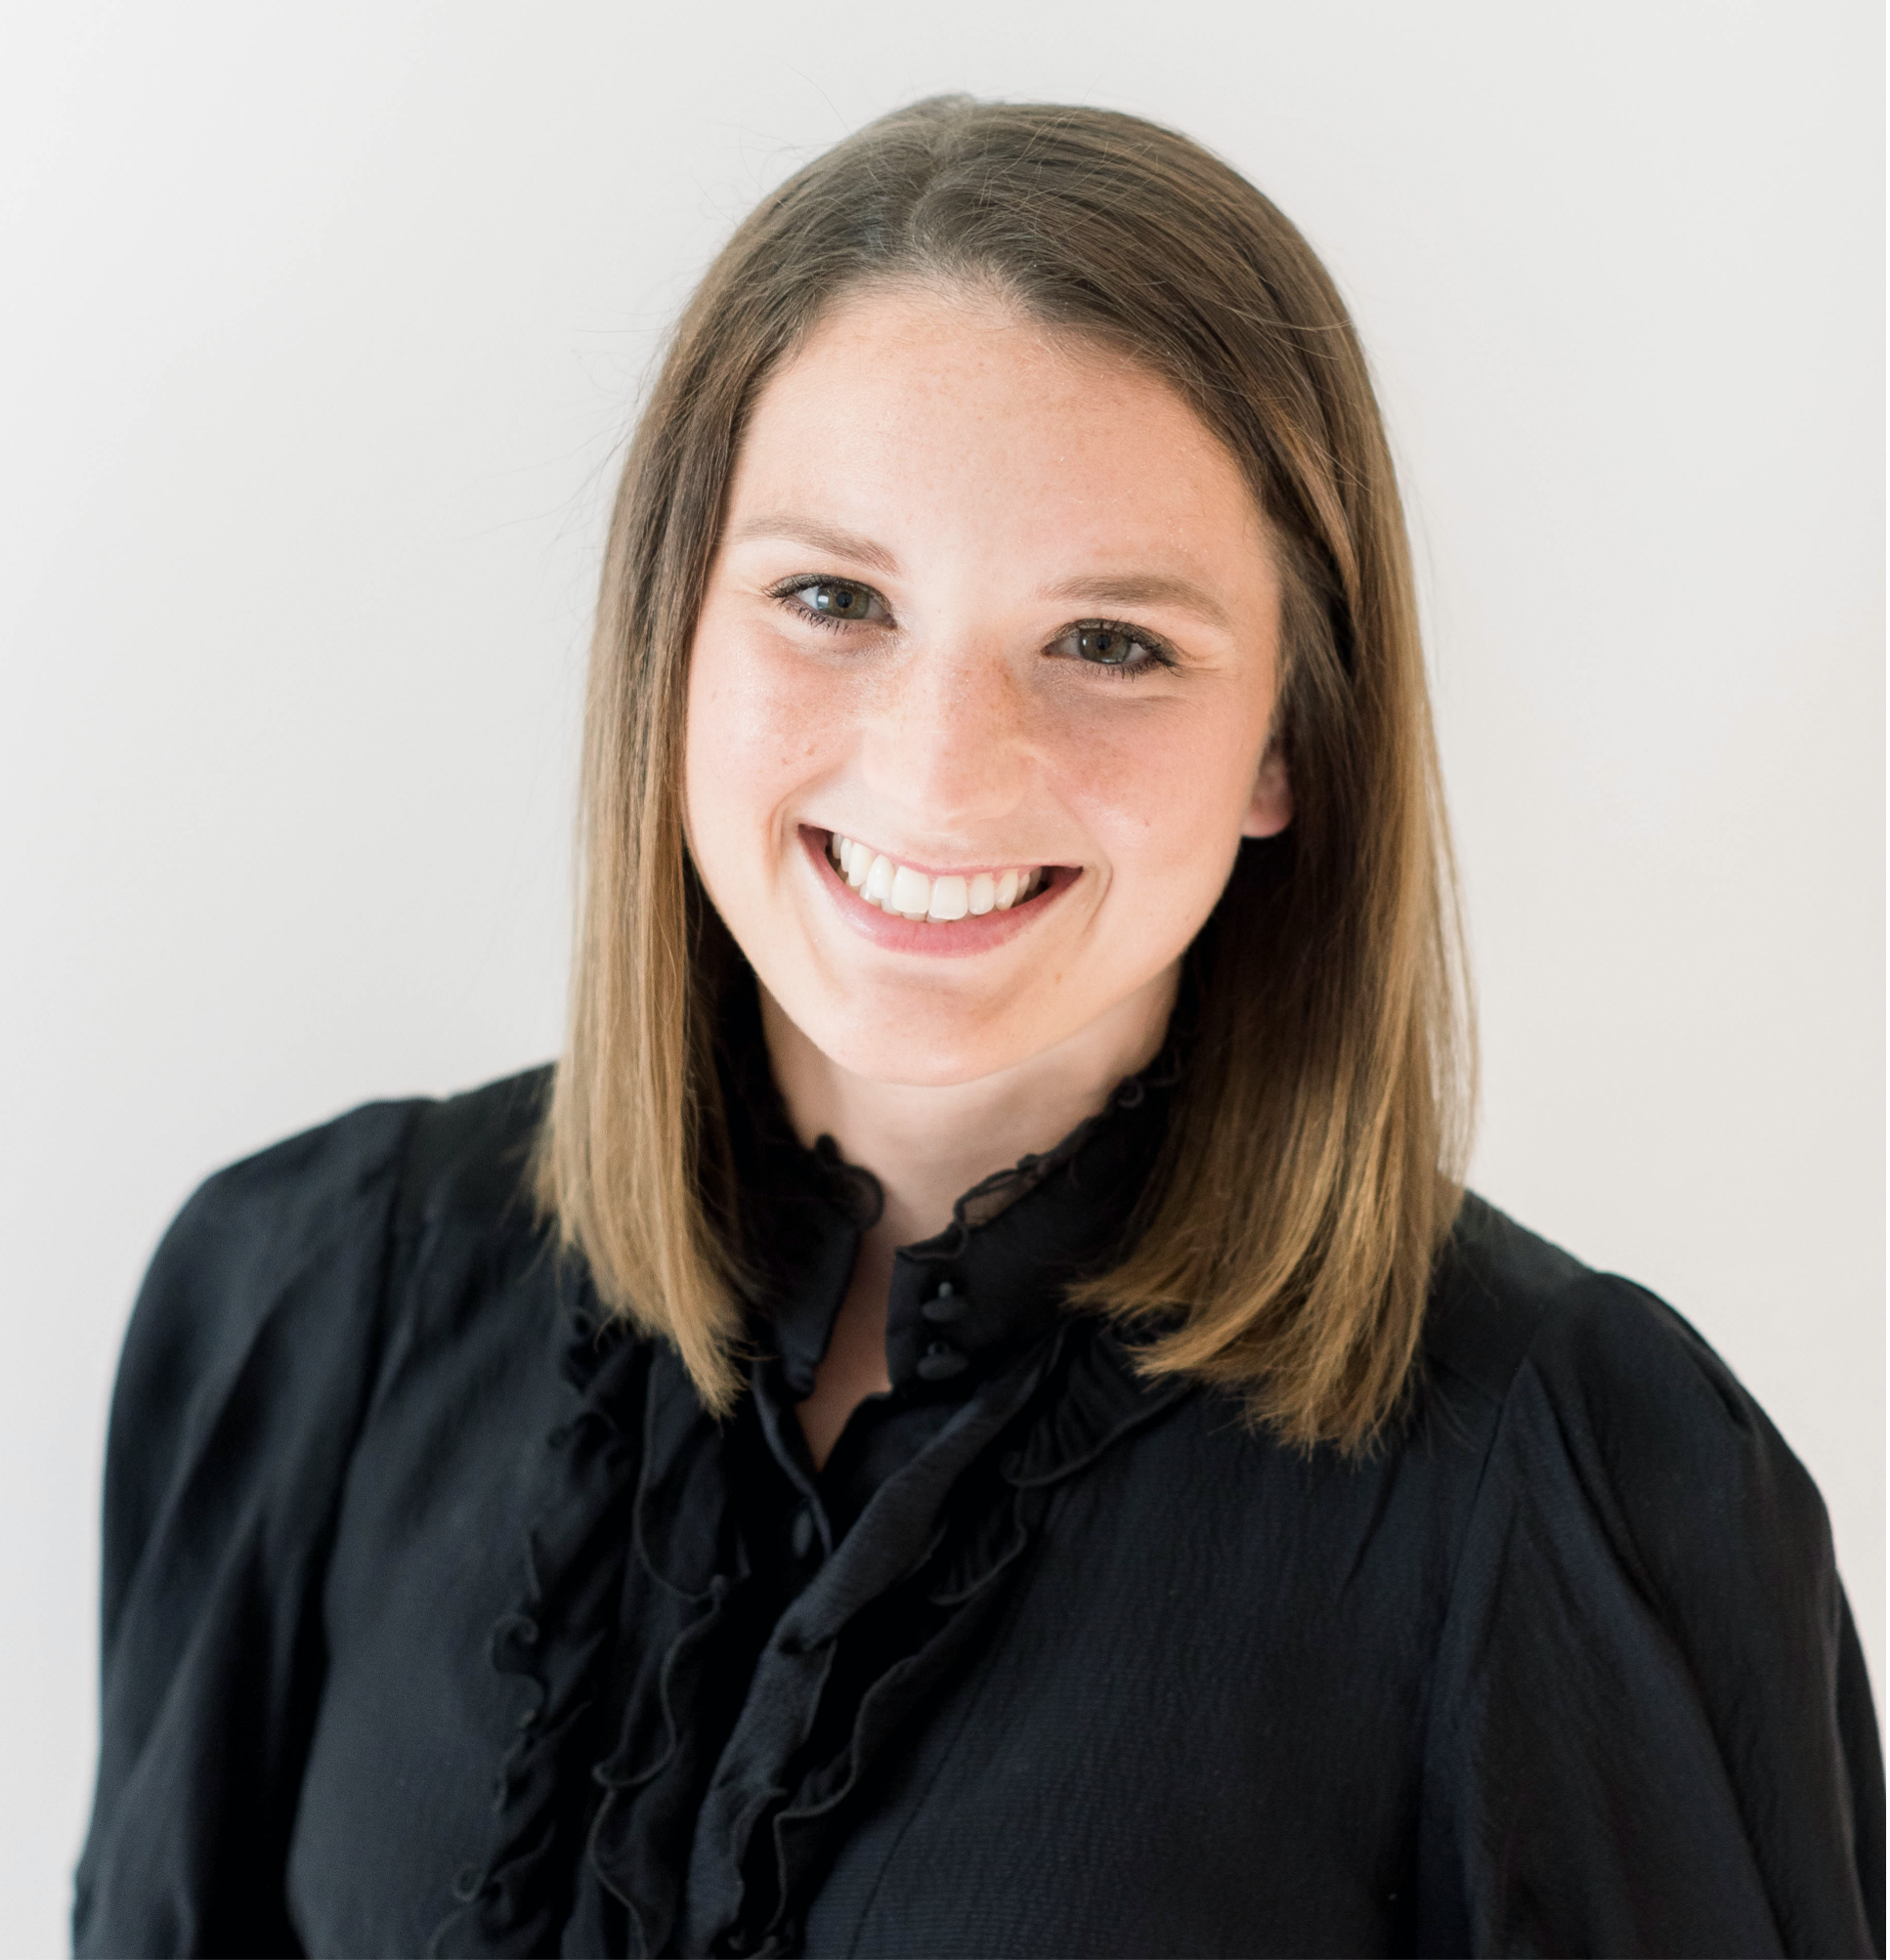
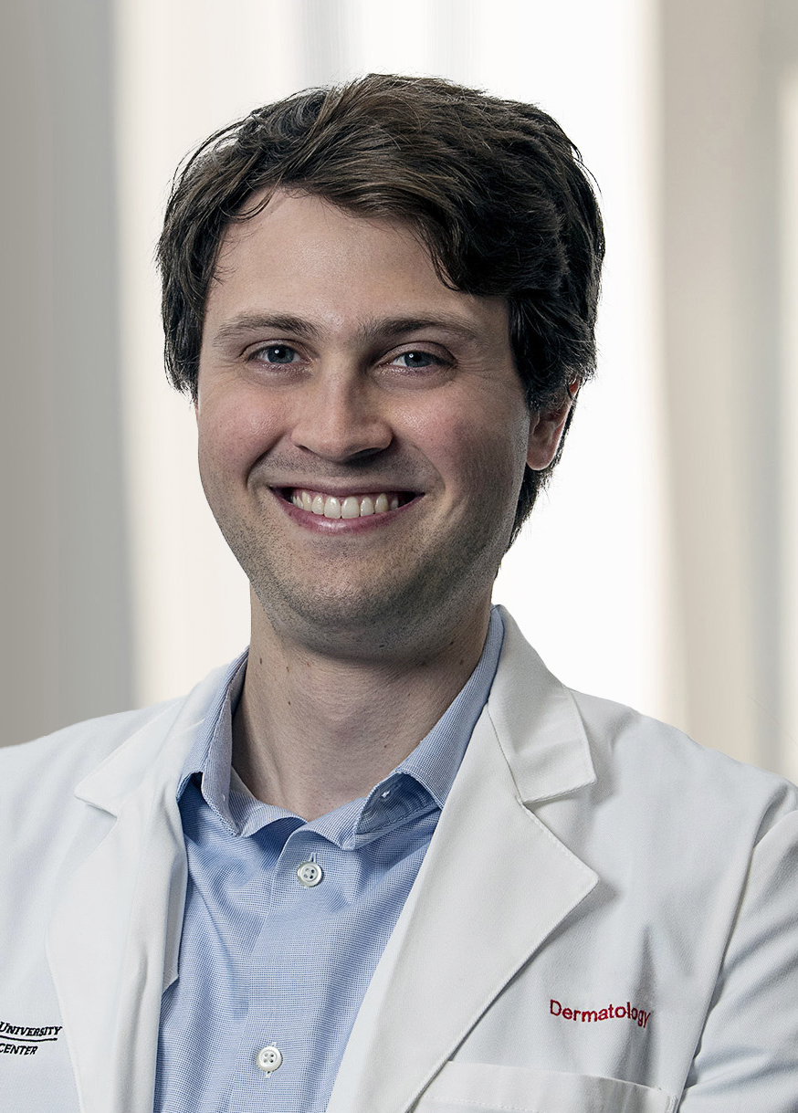
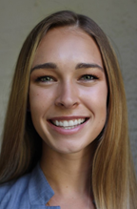
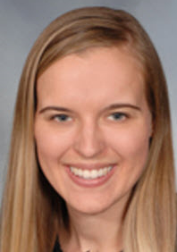
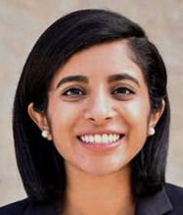
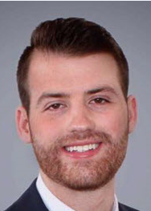
Rachel
Kalyn
Vamsi
Josee
Michela
Paul
Kirsten
2023-2024
Dermatology
Residents
Gabrielle
Kelsey
Manisha
Dan

Slide 6
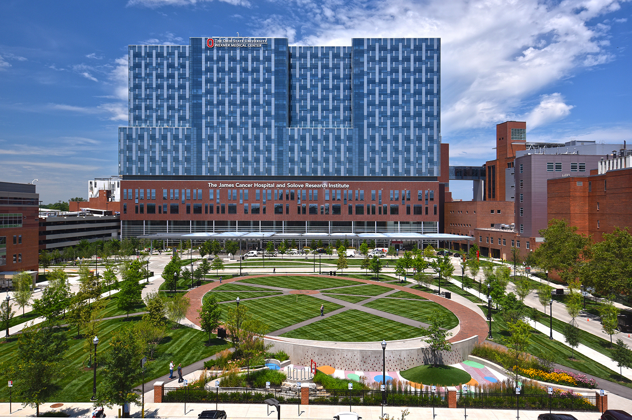
Ohio State Wexner Medical Center-Main Campus

Slide 7
Intern Year
Categorical program- 2 positions connected with OSU preliminary medicine
Advanced position- Internship of applicant's choice

Slide 8
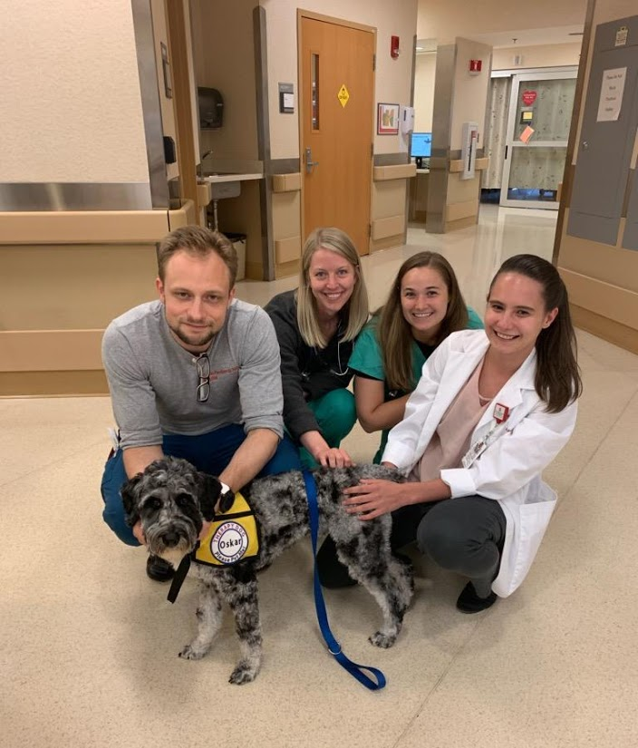
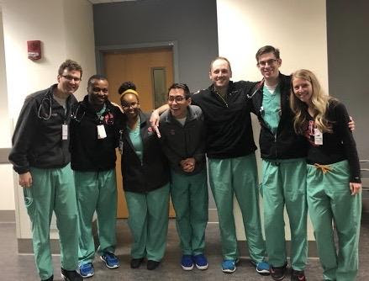
Preliminary Year
5 months of electives (rheum, allergy, research, wound care)
Gen Med
Emergency Medicine
Night Float
Dermatology Inpatient consults
Dermatology Outpatient clinic
NO surgery or ICU required

Slide 9
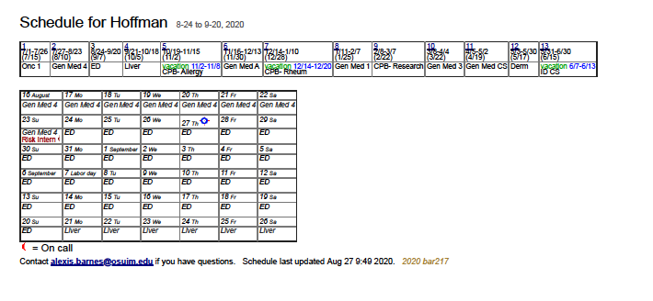
Sample Schedule

Slide 10
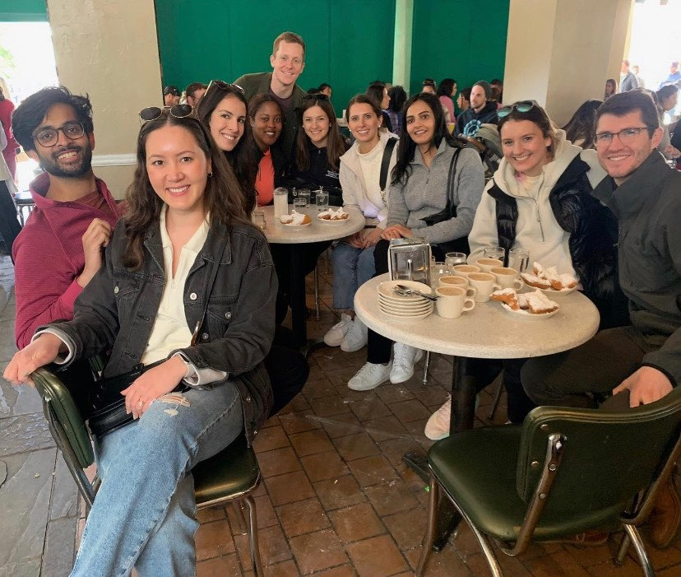
OSU Department of Dermatology
Life After Preliminary Year
Enjoying New Orleans during AAD Conference
No more nights at the hospital!

Slide 11
Block Scheduling

Slide 12
Surgery-Dermatology procedures. Residents are in Derm surgery clinics at the VA, Dermatology West and East locations
Cancer- Skin cancer/oncology block including Mohs surgery. Focusing on the care of skin cancers and skin conditions related to patients with malignancy
Med Derm A- Dermatology outpatient clinic. Psoriasis clinic, rheum dermatology clinic, VA clinics, complex medical dermatology, HIV clinic
Med Derm B- Dermatology outpatient clinic. Psoriasis clinic, rheum derm clinic, VA clinics, complex medical dermatology, vulvar clinic
Pediatric Dermatology- Nationwide Children’s Hospital (vascular malformations clinic, hair clinic, laser clinic, general peds dermatology clinics)
Consults- 4 residents per consult block (1,2,3,4). This includes one week of inpatient dermatology consults with 3 weeks of outpatient dermatology. Residents are on inpatient consults 1 week per month during these blocks
Dermatopathology- sign out with dermatopathology and self study
Cosmetics/Selective- Residents are placed in cosmetic procedure clinics and extra clinics of their choice. Examples may include Rheumatology, additional surgery clinics, allergy clinic
Notes:
Surgery- VA surg (lambert, farhana Thursday); Tuesday RCS; some Mohs; fill-in clinic
2) Cancer- more mohs, VA surg, Tuesday RCS, PLC, some fill-ins
3) Med- PSO, complex, patch, res clinic and fill ins
4) Peds- NCH
5, 6, 7) Consult/DP; extra res clinics; occasaionl PSO/complex clinic fill in
8) Select (1 day per week) - loosely applied- you can do rheum derm, wound, podiatry, etc
9) Misc- where ever we need help

Slide 13
Clinics
Resident continuity x4
Complex
Psoriasis
Contact derm/patch testing
Resident surgery
Mohs x2
VA Surgery clinic
VA tele-dermatology
Nationwide Children’s Hospital
VA continuity clinic
Corrections clinic
Pigmented lesions clinic
Onco-dermatology
HIV
Peel
Vulvar/genital
OSU Telehealth
Senior biopsy clinic
Physician free clinic
Scleroderma
Wound
Lymphedema
Plastics/cosmetics
Laser clinics x2
CTCL

Slide 14
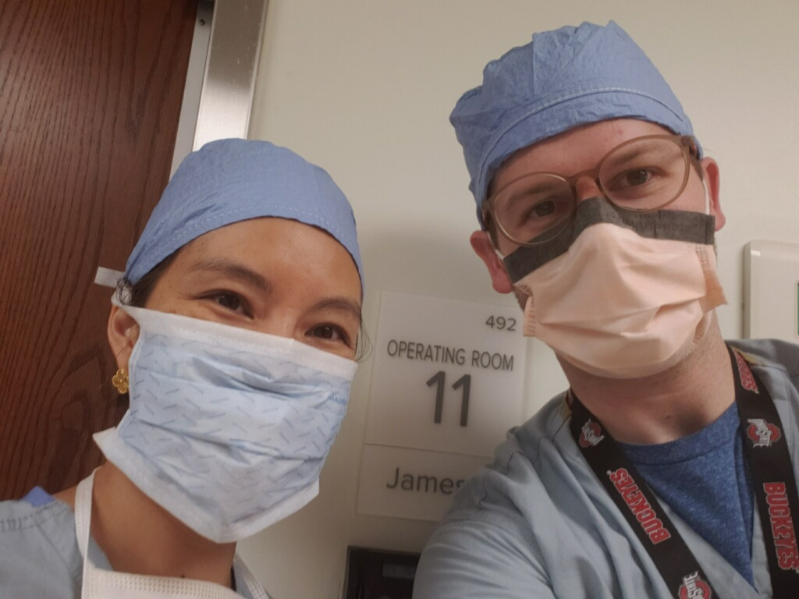
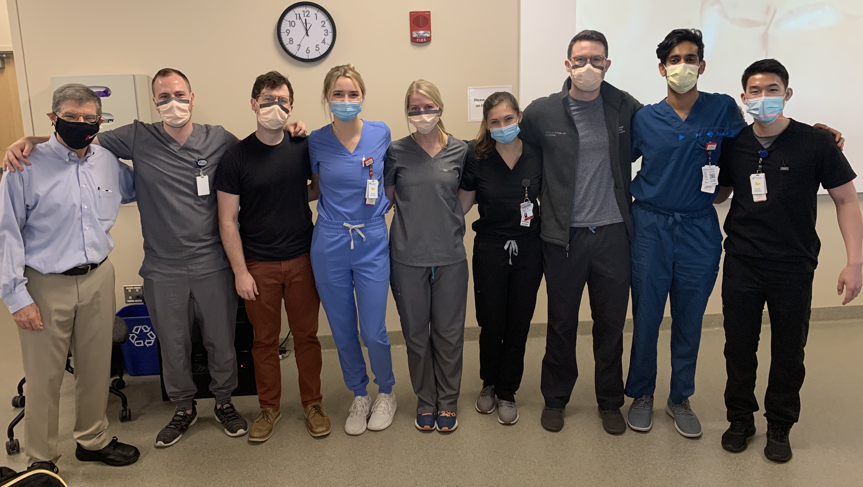
Great day at Mohs!
Didactics
Suture Lab

Slide 15
Dermatopathology
Didactics once weekly (Thursday or Friday mornings)
Additional ½ day sessions depending on block (sign out and self study)
Dermatopathology fellow attends didactics

Slide 16
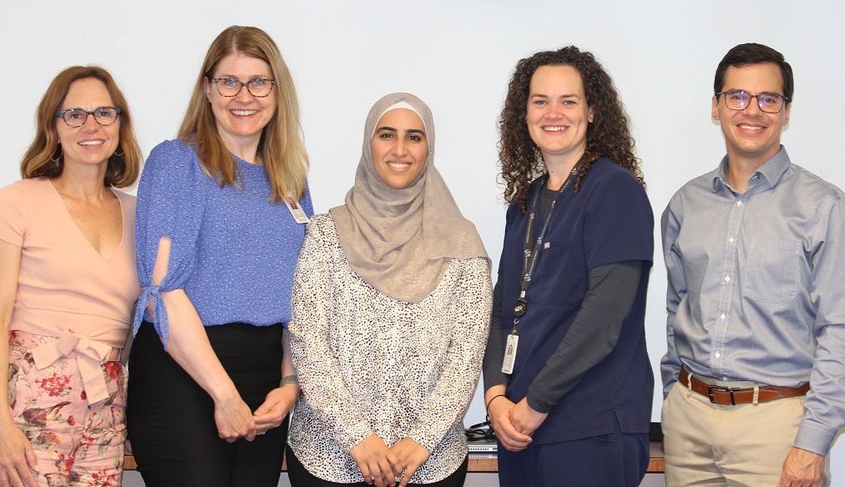
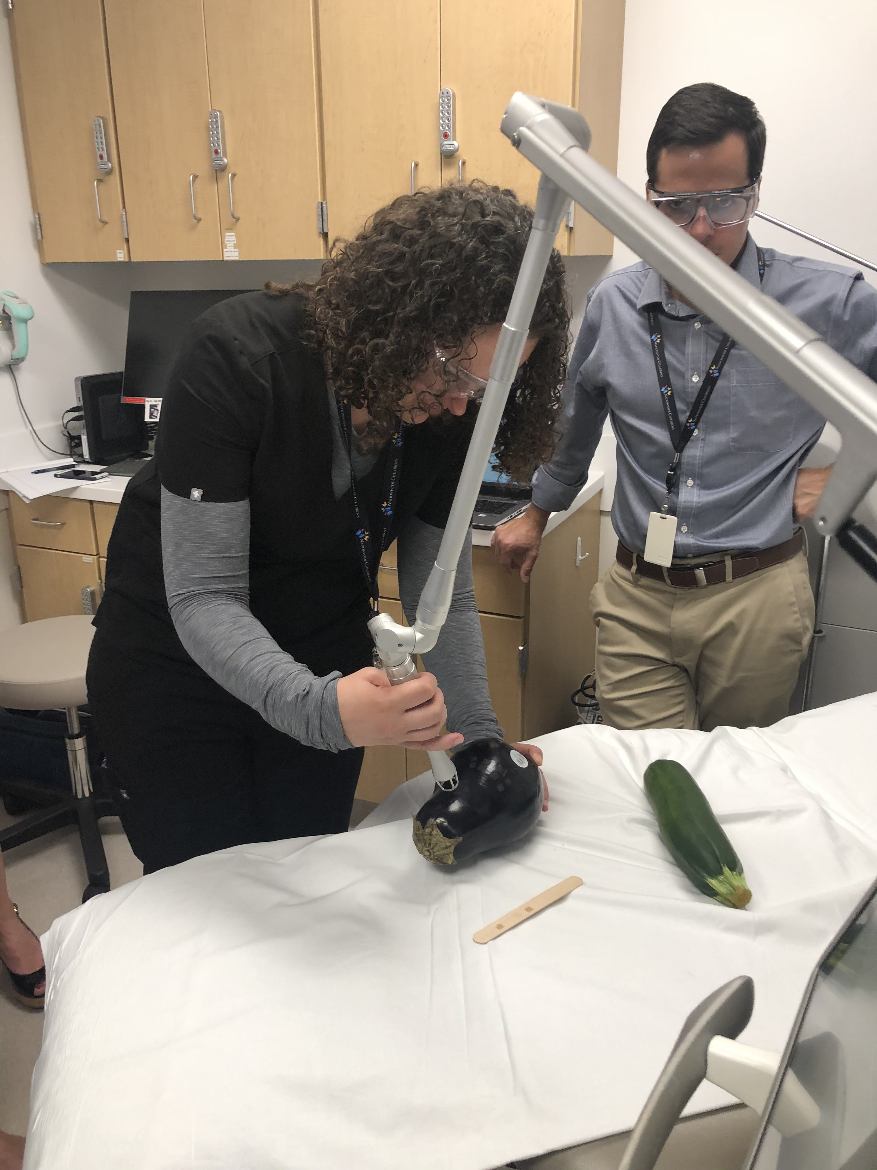
Pediatric Dermatology
4 Pediatric Dermatology attendings on staff
Main hospital clinic
Outpatient clinics
Inpatient Consults
Excisions
Laser in the OR
Excisions in OR

Slide 17
Consults
Covering:
OSU Main Hospital
James Cancer Hospital
Brain and Spine Institute
Ross Heart Hospital
OSU East Hospital
Dodd Rehab
Harding Psychiatric Hospital
1st Year: 6-7 Weeks
2nd Year: 6-7 Weeks
3rd Year: 2-3 Weeks
Dr. Benjamin Kaffenberger 1 week/month
Dr. Abraham Korman 2 weeks/month
Dr. Kristopher Fisher 1 week/month

Slide 18
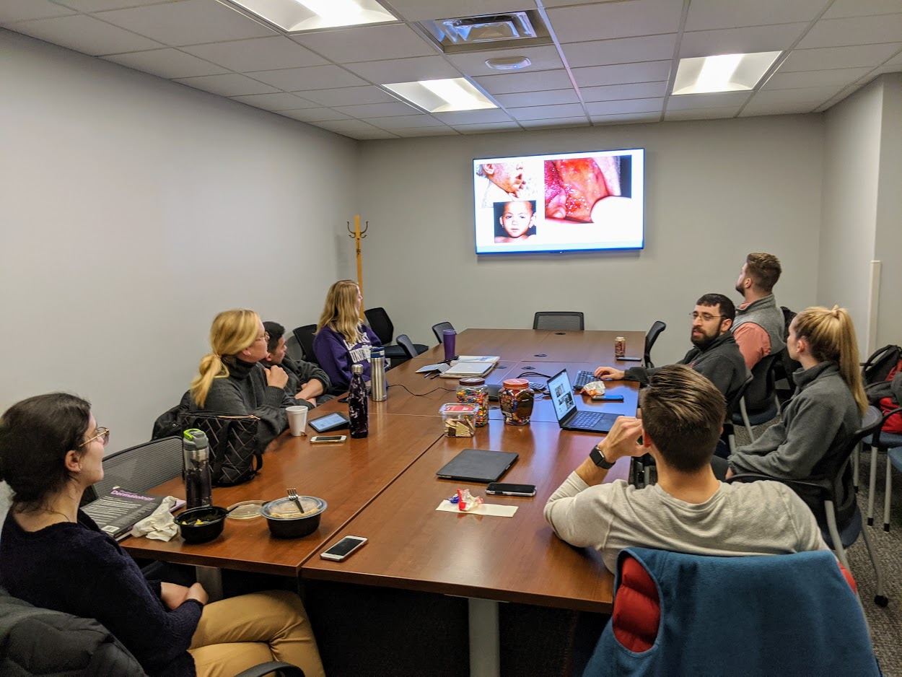
Didactics
Wednesday 1-5 PM
Surgery
Pediatric Dermatology
General Dermatology
Pharmacology
Cosmetics
Chapter reviews
Rapid reviews
CME
Attending Lectures
Journal club
Kodachromes
Board review lectures

Slide 19
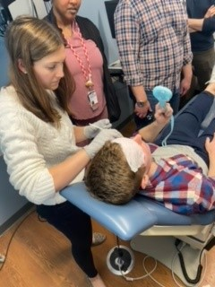
Resident Cosmetic Sessions Every 3 months
Botox
Fillers
Lasers
Micro needling
Peels
PRP
Aquagold

Slide 20
Funding
Annual Resident stipend
Books provided using CME stipend
Main campus parking pass stipend
Dermatoscope and lab coats provided
Board Review stipend
Travel and Expenses covered for AAD using CME stipend
Additional money available if presenting at a conference

Slide 21
FAQ-find it all here
How much Mohs and Cosmetic exposure do your residents get? Residents get significant exposure to Mohs during all three years of dermatology residency. During their dedicated surgical blocks (~12 weeks/year), we work directly with Drs. Carr and Pootrakul as well as the Mohs fellow to hone their surgical skills. Both of our Mohs attendings do most of their own flaps/reconstructions, which is a great experience for our residents regardless of interest in Mohs fellowship (flap design is tested on the boards). As residents get more comfortable with their surgical technique, their involvement in taking layers and doing closures increases.
Our department has invested substantially in this area in recent years and this impact has been felt at the level of resident education. Drs. Plotner, Shipp, and Sopkovich run our cosmetic curriculum and all three are selfless with their time and tremendous teachers. Our cosmetic curriculum is focused on understanding anatomy, appropriate technique, and patient safety. We hold quarterly resident cosmetic sessions during which we offer free procedures to patients, staff, and family - injectables (e.g., neuromodulator, filler), laser hair removal, resurfacing laser, PicoSure laser (tattoo removal, etc.), vascular laser, radiofrequency, to name a few. A lot of these are newer technologies that the department has purchased. Beyond these sessions, residents rotate with Dr. Shipp in his cosmetic clinic in New Albany. Residents often do procedures on his patients, and we also have the option to bring our own patients to this clinic and provide them with cosmetic services free of charge! This is a great option for resident clinic patients who otherwise might not be able to afford the service.
How much exposure do residents get to CTCL? Residents usually do 1 to 2 ½ day clinics per year. All residents have the opportunity to choose to rotate thru additional CTCL clinics.

Slide 22
FAQ-find it all here
What is your rural/underserved population like and how much interaction do residents get with them? OSU provides excellent care regardless of race, ethnicity or socioeconomic status.
A high percentage of resident clinics and pediatric dermatology clinics come from an underserved, urban or rural population. Ohio State and Nationwide Children’s Hospital serve as the largest medical centers for surrounding rural communities (southern Ohio, Kentucky, and West Virginia). Additionally, OSU Dermatology has an HIV clinic run that is run jointly with infectious disease specialists. Residents also treat patients who are incarcerated at the Franklin Medical Center Corrections Clinic. Residents and faculty also volunteer at the Columbus Free Clinic as well as the Latino Free Clinic.
Opportunities for resident-driven basic science and translational research? OSU is a huge medical center and one of the most comprehensive with 7 health science colleges conducting research within the medical center. There are numerous opportunities in the fields of carcinogenesis, wound healing, virology, microbial pathogenesis and immunity but require the right resident and experience.
What are the most robust research projects currently ongoing in the dermatology department?
We have strong and broad clinical research opportunities especially in the following thematic areas:
Inpatient Dermatology and Hospital Outcomes
Cutaneous SCC outcomes
Supportive Oncodermatology
Pediatric Dermatology
Telemedicine and Underserved
Clinical Trials in psoriasis, eczema, pyoderma gangrenosum, hidradenitis suppurativa, alopecia areata, and lupus among less common skin disease.

Slide 23
FAQ-find it all here
Are DO applicants considered? Yes
Are international medical graduates considered? Yes
Do you offer opportunities to explore and pursue different career paths, such as clinical practice or fellowships? Yes. Residents are given the opportunity to spend time with OSU Dermatology faculty in their private practice-based clinics. Due to having multiple fellowships (Mohs, Peds, Path & Clinical Research) residents have the opportunity to explore many opportunities.
Is your curriculum influenced more by research or clinical time? OSU Dermatology is highly focused on clinical dermatology. Research opportunities are usually self-directed by the resident.
How much elective time do residents get during the program? 4 weeks
Is the standardized LOR required for consideration for interview? No, it is not required. All types of LORs are accepted. 3 LORs are recommended.
Are residents allowed to use elective time for volunteering opportunities such as at Camp Discovery or other AAD/nationally accredited volunteering program? Yes
What pipeline and community service initiatives are residents involved with? We participate in free clinics with the Columbus Dept. of Public Health and the State of Ohio Corrections clinic.

Slide 24
FAQ-find it all here
Is there exposure to teledermatology? Yes. Residents participate in teledermatology clinics at NCH, VA and Inpatient teleconsults at OSU East.
Does your program consider applicants who have/will have completed a different residency? Yes.
Are there clinics dedicated to the dermatologic care of LGBTQ / SGM patients? We do not have a specific clinics for only LGBTQ/SGM patients; however, we have a robust LGBTQ/SGM population in Columbus and take care of many LGBTQ/SGM patients in all of our clinics.
How do OSU dermatology residents gain leadership skills? Residents have graduated administrative duties within the residency including Grand Rounds, medical student scheduling and education, planning for cosmetic sessions within their second year. During the third year of residency, duties include arranging didactic sessions, scheduling residents, serving on program evaluation committee, serving on applicant interview committee. Outside of the institution, residents may sit on the board of the Ohio Dermatologic Association, participate in the AADA Legislative Conference, AAD resident committee.
How much surgery do your first-year residents participate in?
First-year residents receive a lot of hands-on surgical training at OSU Dermatology. For the first six months of residency, you are generally paired with an upper-level resident and/or attending. You will perform procedures in various settings including the veteran's affair (VA) facility, a dedicated first year resident surgery clinic, and a senior level resident surgery clinic. Throughout the year, you gain graduated autonomy in these clinics and by the end of your first year, you will feel comfortable with basic surgical procedures including benign and malignant excisions.

Slide 25
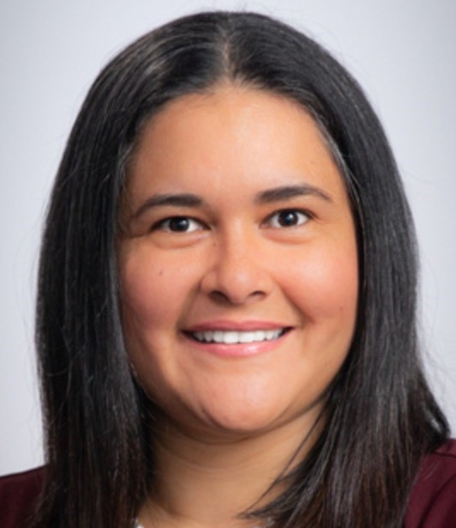
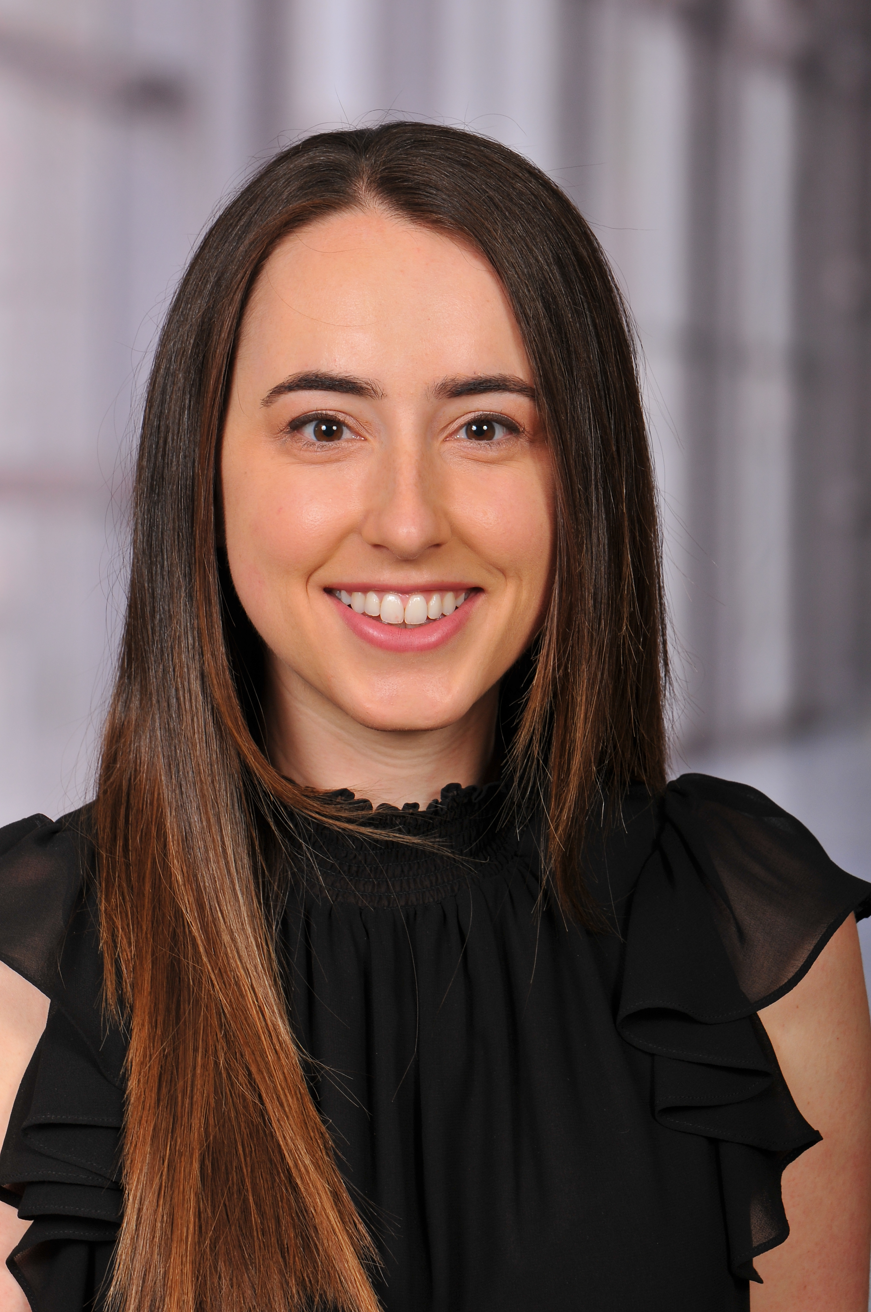
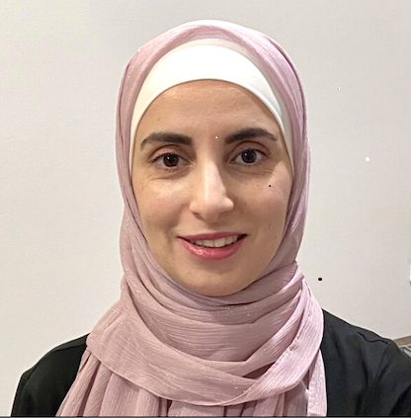
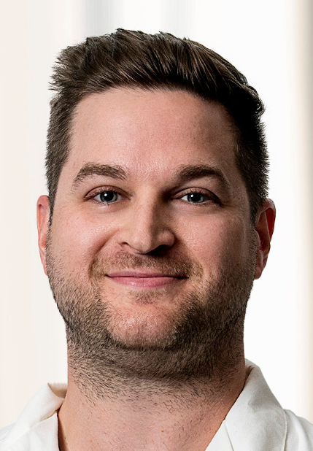
Fellowships
Dr. Bianka Bubic
2023-2024 Clinical Research Fellow
Dr. Alba Posligua Alban
2023-2024 Mohs Fellow
Dr. Elham Zayed
2023-2024 Pediatric Dermatology Fellow
Dr. Andrew Krispinsky
2023-2024 Dermatopathology Fellow

Slide 26
Conferences
Ohio Dermatological Association
American Academy of Dermatology
American Society for Dermatologic Surgery
Society for Pediatric Dermatology
American Contact Dermatitis Society
American College of Mohs Surgery
AADA Legislative Conference

Slide 27
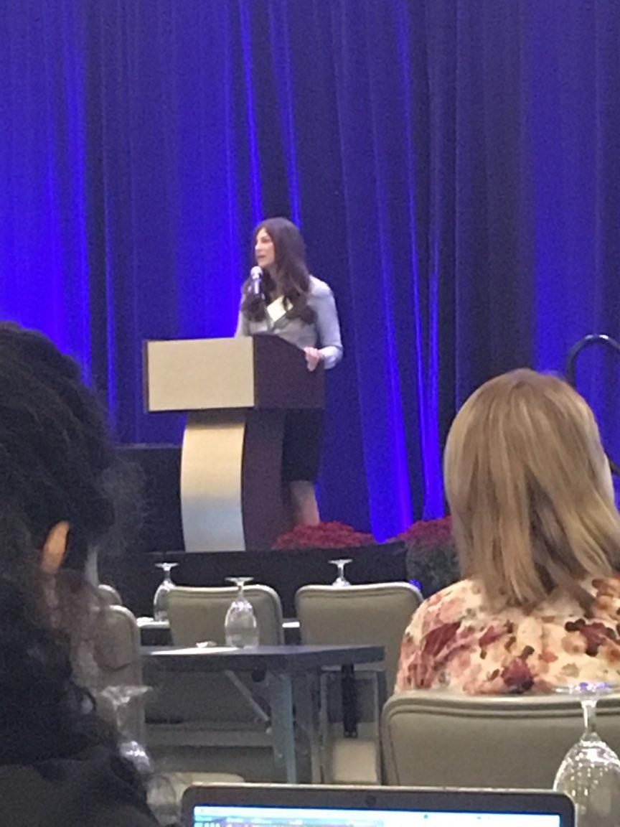
Ohio Dermatological Association

Slide 28
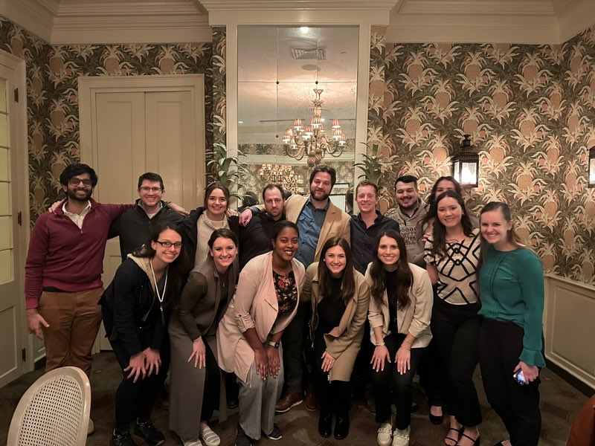
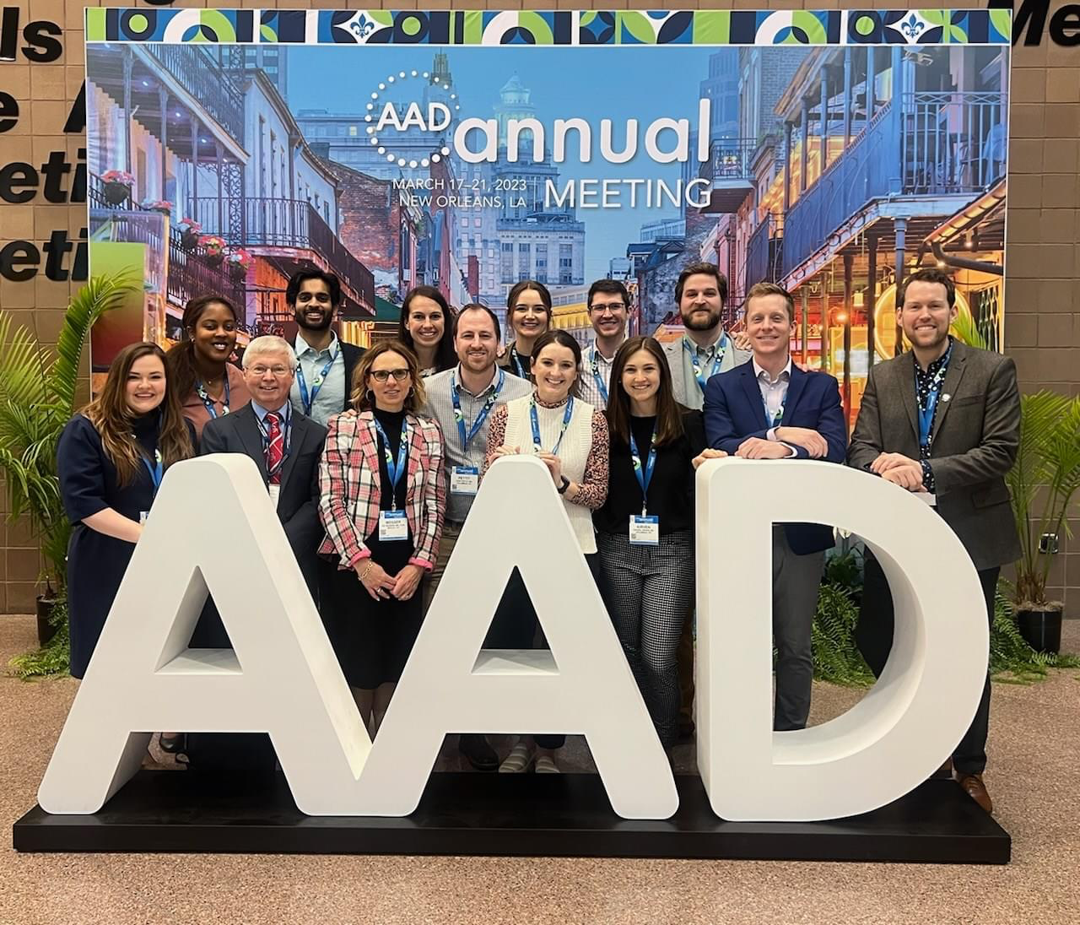
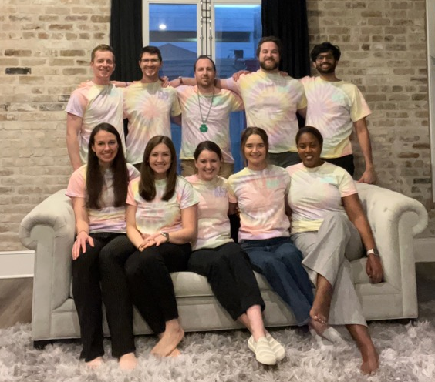
American Academy
of
Dermatology

Slide 29
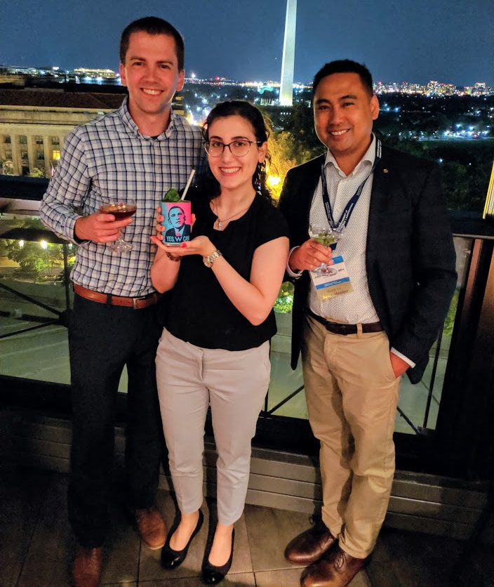
American Academy of Dermatology

Slide 30
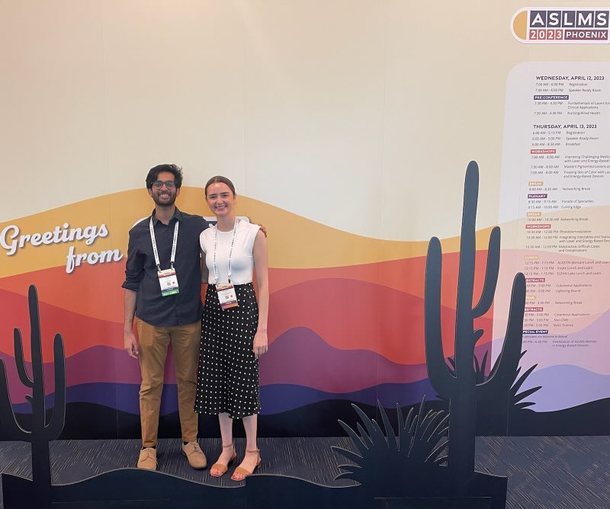
ASLMS 2023

Slide 31
Things we love about OSU Dermatology
Diverse pathology with the care of many complex diseases
Close knit group of co-residents
Dedication to Community Outreach
Energetic faculty excited and dedicated to teaching
Numerous Specialty Clinics
Representation of all skin types
Pediatrics (with 4 Pediatric Dermatologists)
High-acuity and complex Inpatient Consult service
Fellowships in Pediatric Dermatology, Mohs, Clinical Research &
Dermatopathology
Opportunities for research and conferences
The City of Columbus and being able to cheer for the Buckeyes!

Slide 32
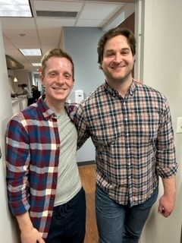
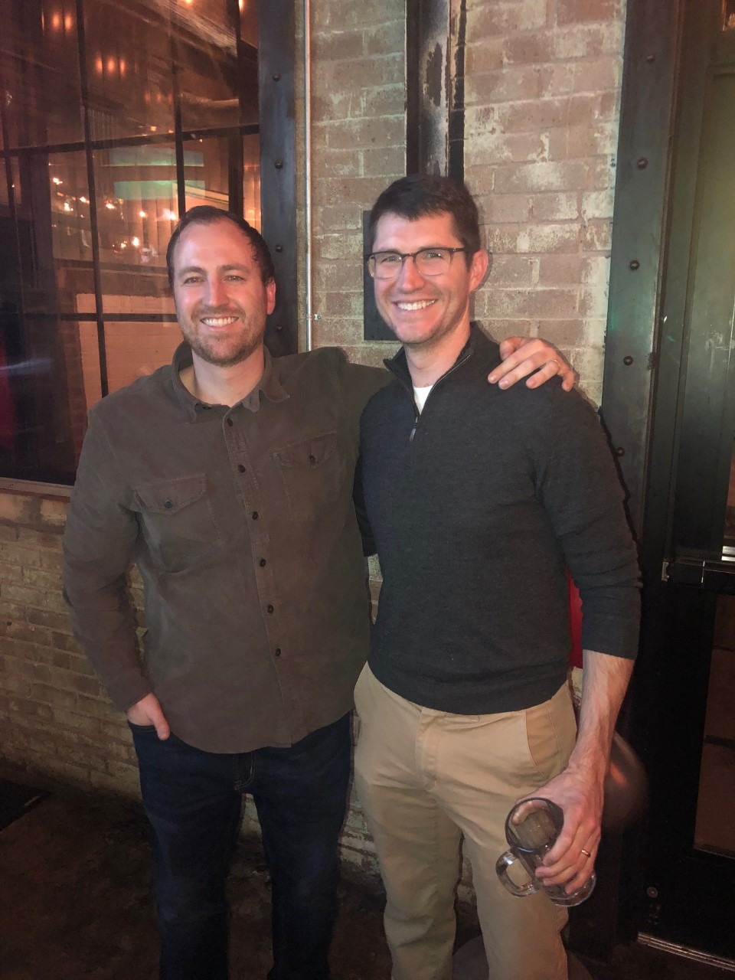
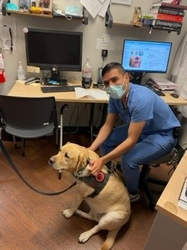
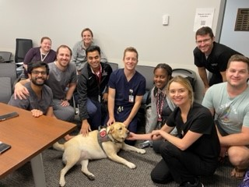
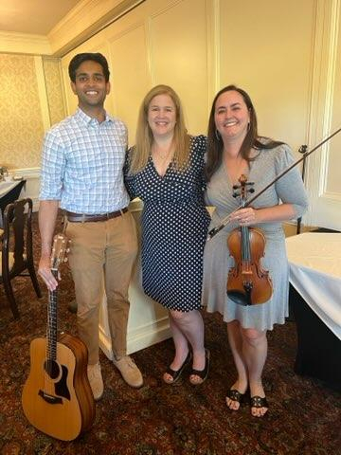

Slide 33
Columbus
At-A-Glance
Columbus is the state capital and the most populous city in the state of Ohio. It is the 14th-most populous city in the U.S., the second-most populous city in the Midwest, after Chicago, and the third-most populous state capital.
The city has a diverse economy based on education, government, insurance, banking, defense, aviation, food, clothes, logistics, steel, energy, medical research, health care, hospitality, retail, and technology. The metropolitan area is home to the Battelle Memorial Institute, the world's largest private research and development foundation; Chemical Abstracts Service, the world's largest clearinghouse of chemical information; and the Ohio State University, one of the largest universities in the United States. As of 2021, the Greater Columbus area is home to the headquarters of six corporations in the U.S. Fortune 500: Cardinal Health, American Electric Power, L Brands, Nationwide, Alliance Data, and Huntington Bancshares.

Slide 34
Thank you for joining us!
Please click the links below to take a tour of our facilities, enjoy a tour of our wonderful city and diverse culture and sign up to receive a Visitor Guide!
Ohio State Dermatology Facilities Tour
Experience Columbus Tour
CBUS Soul
Sign Up for a Visitor Guide

