Slide 1
Dossier Quality Indicators: How and Where to Find Them Stephanie Schulte, MLIS Associate Professor Head, Research and Education Services OSU Health Sciences Library
©Stephanie Schulte 2021

Slide 2
Overarching Premise
All of the metrics we’ll discuss today are based on counting citations to articles.
Citing behavior in various disciplines varies tremendously.
Even subfields can differ from parent field.

Slide 3
Big Players in Tracking Citations
Web of Science
Source of Impact Factor; tracks older citations well if journal is indexed; newer interfaces may provide ability to track citations in other WoS databases not traditionally included. Most restrictive coverage.
Scopus
Newer database; coverage goes back to about 1996; broader scope of journals included. Less restrictive coverage.
Google Scholar
Coverage not fully understood; uses broad definition of scholarship; profiles available. Least restrictive coverage.

Slide 4
Common Metrics Used in Dossier: All Based on Citations to Articles
Journal Metrics: Journal Citation Reports (Based on Web of Science Data)
Impact Factor
Journal Rankings based on Impact Factor
Author Metrics: Scopus, Web of Science, or Google Scholar
H-index
Article Metrics: Web of Science, Scopus, or Google Scholar
# of citations
Article Citations
Impact Factors
H-index
Rankings by Category

Slide 5
Impact Factor
Derived from citations to journal articles indexed in Web of Science over a 2-year period of time (deemed “citable items”)
Reported annually in Journal Citation Reports
Some disciplines are covered very well in WoS, while others are not, thus many journals may not have IFs.
Of particular interest: new journals
2016 reference exploring coverage: https://link.springer.com/article/10.1007/s11192-015-1765-5
When looking at an item to know whether there is an impact factor associated with the source where it is published, first ask yourself, is this a journal article or some other type of article/item? Then, is the journal in Web of Science?

Slide 6
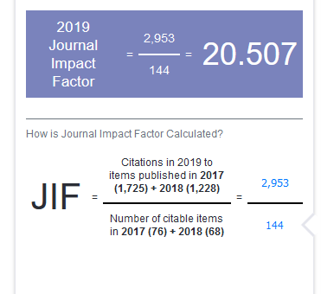
Calculate Impact Factor
2016 IF =
2016 cites to articles in the journal published 2014-2015
--------------------------------------------------------------Number of citable items 2014-2015
2019 IF for Cell Research

Slide 7
Author Metrics: h-index
Hirsch (a physicist) developed this in 2005, trying to measure the productivity and citation impact of a particular scholar.
“A scientist has index h if h of his/her Np papers have at least h citations each, and the other (Np−h) papers have no more than h citations each.”
Put simply, the intersection of the number of papers published by an author and the number of times they’ve been cited.

Slide 8
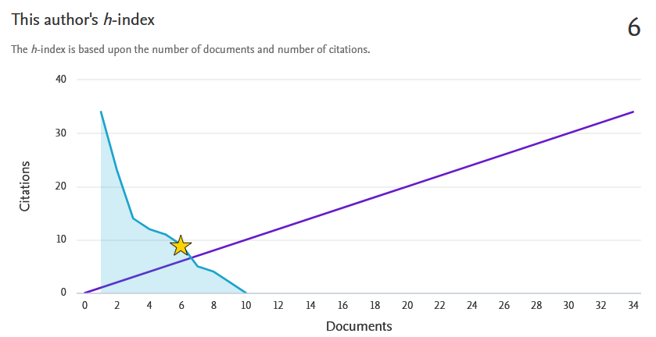
Image from Scopus, Stephanie J. Schulte profile

Slide 9
Live Demo
Impact factor for a journal via Web of Science/Journal Citation Reports
Journal Rankings in Web of Science/Journal Citation Reports
Number of citations to journal publication via Web of Science, Scopus, and Google Scholar
H-index for a specific researcher (via all 3)
REFERENCE GUIDE: Measuring Scholarly Impact
https://hslguides.osu.edu/researchimpact
Journal IFs and rankings tutorial: https://hsl-osu.libwizard.com/f/ImpactFactors_JournalRatings

Slide 10
Contact Info
Librarians: can help pull this data if you’re having trouble
COM (non pediatrics): Stephanie.Schulte@osumc.edu or Kaitlyn.Feyh@osumc.edu
SHRS: Anna.Biszaha@osumc.edu
NCH Library: library3@nationwidechildrens.org or call 614-722-3200
FAME: fame@osumc.edu
Departmental Faculty Affairs Coordinators: dossier/P&T questions, etc.
Crista Marbley, Faculty Affairs Coordinator, Pediatric Academic Association, Marbley, Crista.Marbley@nationwidechildrens.org
Suzanne Knott, Faculty Affairs Coordinator, Dept. of Surgery, Suzanne.Knott@osumc.edu

