Slide 1
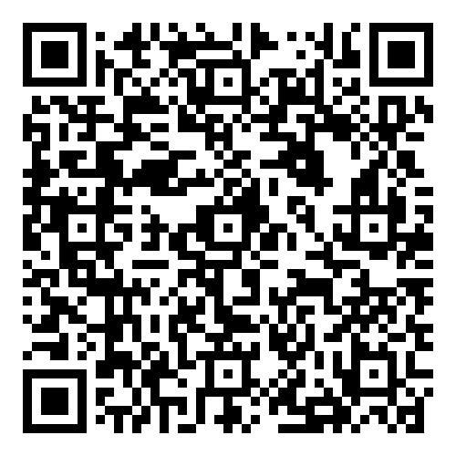
Title: Arial Bold 95 Pts. Authors: Your name here Affiliations: Affiliations here
Presentation #:
Purpose
Results
Conclusions
Standard Text Box
Arial 35 pts.
Line Spacing 0.9 Before Paragraph 0.4 After Paragraph 0.0
Standard Text Box
Arial, 35 pts.
Line Spacing 0.9 Before Paragraph 0.4 After Paragraph 0.0
Chart, Graph or Table Heading: Arial Bold 35 Pts.
Text Box with Bullet Points
Arial, 35 pts.
Line Spacing 0.9 Before Paragraph 0.4 After Paragraph 0.0
Text Box with Numbered Points
Arial 35 pts.
Line Spacing 0.9 Before Paragraph 0.4 After Paragraph 0.0
Text Box with Numbered Points
Arial, 35 pts.
Line Spacing 0.9 Before Paragraph 0.4 After Paragraph 0.0
Text Box with Bullet Points
Arial 35 pts.
Line Spacing 0.9 Before Paragraph 0.4 After Paragraph 0.0
References
Methods &
Materials
Photo
1 pt. outline; third color from left in color scheme
Photo Caption: Arial, 35 pts.
Acknowledgments
Full Disclosure
Additional support came from the Ohio State University Vision Sciences Research Core Program (OSU-VSRCP, P30EY032857) and Research to Prevent Blindness (RPB) New Chair Challenge Grant.
Full disclosure will include the name(s) of the commercial interest and the nature of the relationship(s). Indicate “None” if no relationships exist.
YourEmailHere@osumc.edu

